Slide 1
COCOMO 1
Formulas

Slide 2
Basic COCOMO Model Equations
Effort = a × (KLOC) ^{(b}_{i}⁾. , unit=person-months
Development Time = c × (Effort) ^{(d}_{i}⁾. , unit=months
Average Staff Size = (Effort) / (Development Time), unit=persons
Productivity = (KLOC) / (Effort) , unit = kloc/person-month

Slide 3
Basic COCOMO Model Constants
Software Projects | a₁ (a) | a₂ (b) | b₁ (c) | b₂ (d)
Organic | 2.4 | 1.05 | 2.5 | 0.38
Semi-Detached | 3.0 | 1.12 | 2.5 | 0.35
Embedded | 3.6 | 1.20 | 2.5 | 0.32

Slide 4
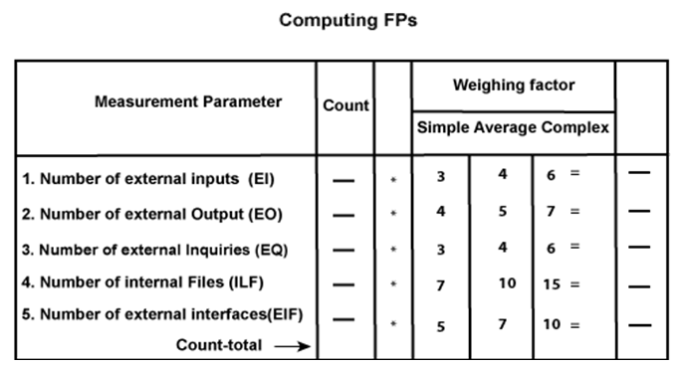
Cost Estimation based on Functional Point (FP) Analysis
Following are the Essential points regarding FPs
All the parameters mentioned above are assigned some weights that have been experimentally determined and are shown in Table.

Slide 5
Cost Estimation based on Functional Point (FP) Analysis
Following are the Essential points regarding FPs
Here that weighing factor will be simple, average, or complex for a measurement parameter type. The
Function Point (FP) is thus calculated with the following formula.
FP = Count-total * [0.65 + 0.01 * ∑(f_{i})] = Count-total * CAF
where Count-total is obtained from the above Table.
CAF = [0.65 + 0.01 *∑(f_{i})]
and ∑(f_{i}) is the sum of all 14 questionnaires and show the complexity adjustment value/ factor-CAF (where i ranges from 1 to 14). Usually, a student is provided with the value of ∑(f_{i})
Also note that ∑(f_{i}) ranges from 0 to 70, i.e.,
0 <= ∑(f_{i}) <=70
and CAF ranges from 0.65 to 1.35 because
When ∑(f_{i}) = 0 then CAF = 0.65
When ∑(f_{i}) = 70 then CAF = 0.65 + (0.01 * 70) = 0.65 + 0.7 = 1.35

Slide 6
Cost Estimation based on Functional Point (FP) Analysis
Following are the Essential points regarding FPs
Based on the FP measure of software many other metrics can be computed:
Errors/FP
$/FP.
Defects/FP
Pages of documentation/FP
Errors/PM.
Productivity = FP/PM (effort is measured in person-months).
$/Page of Documentation.

Slide 7
Cost Estimation based on Functional Point (FP) Analysis
Following are the Essential points regarding FPs
LOCs of an application can be estimated from FPs. That is, they are interconvertible. This process is known as backfiring. For example, 1 FP is equal to about 100 lines of COBOL code.
FP metrics is used mostly for measuring the size of Management Information System (MIS) software.
But the function points obtained above are unadjusted function points (UFPs). These (UFPs) of a subsystem are further adjusted by considering some more General System Characteristics (GSCs). It is a set of 14 GSCs that need to be considered. The procedure for adjusting UFPs is as follows:
Degree of Influence (DI) for each of these 14 GSCs is assessed on a scale of 0 to 5. If a particular GSC has no influence, then its weight is taken as 0 and if it has a strong influence then its weight is 5.
The score of all 14 GSCs is totaled to determine Total Degree of Influence (TDI).
Then Value Adjustment Factor (VAF) is computed from TDI by using the formula: VAF = (TDI * 0.01) + 0.65

Slide 8
Cost Estimation based on Functional Point (FP) Analysis
Following are the Essential points regarding FPs
Remember that the value of VAF lies within 0.65 to 1.35 because
When TDI = 0, VAF = 0.65
When TDI = 70, VAF = 1.35
VAF is then multiplied with the UFP to get the final FP count: FP = VAF * UFP

Slide 9
Cost Estimation based on Functional Point (FP) Analysis
Example: Compute the function point, productivity, documentation, cost per function for the following data:
Number of user inputs = 24
Number of user outputs = 46
Number of inquiries = 8
Number of files = 4
Number of external interfaces = 2
Effort = 36.9 p-m
Technical documents = 265 pages
User documents = 122 pages
Cost = $7744/ month
Various processing complexity factors are: 4, 1, 0, 3, 3, 5, 4, 4, 3, 3, 2, 2, 4, 5.

Slide 10
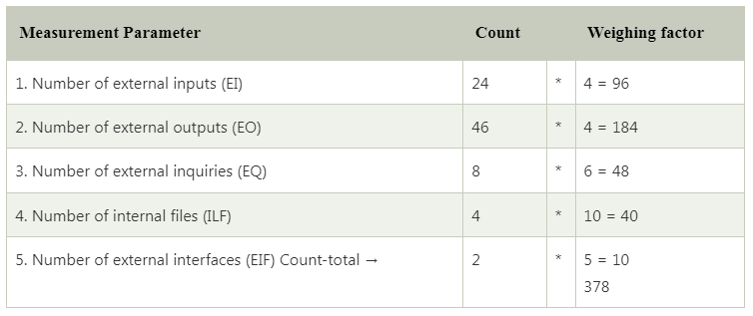
Cost Estimation based on Functional Point (FP) Analysis
Solution:

Slide 11


Cost Estimation based on Functional Point (FP) Analysis
Solution:
So sum of all f_{i} (i ← 1 to 14) = 4 + 1 + 0 + 3 + 5 + 4 + 4 + 3 + 3 + 2 + 2 + 4 + 5 = 43
FP = Count-total * [0.65 + 0.01 *∑(f_{i})] = 378 * [0.65 + 0.01 * 43] = 378 * [0.65 + 0.43] = 378 * 1.08 = 408
Total pages of documentation = technical document + user document = 265 + 122 = 387pages
Documentation = Pages of documentation/FP = 387/408 = 0.94

